Slide 1
SUDOKO SOLVER
~ ANUSHREE

Slide 2
INTRODUCTION
Project Title
Sudoku Solver with AI Search Algorithms
Aim
The primary aim of this project is to create an interactive Sudoku puzzle solver that leverages various artificial intelligence and search algorithms to solve puzzles efficiently
O bjective
The objective of this project is to develop and compare Sudoku-solving algorithms using classical search methods (such as DFS or A*) and reinforcement learning (Q-Learning or DQN) to accurately solve Sudoku puzzles of varying difficulty, evaluate their performance through metrics, and visualize results using an interactive graphical interface.

Slide 3
LITERATURE REVIEW
Sudoku solving is a fun puzzle that's great for testing AI ideas. It's like filling a 9x9 grid so no number repeats in rows, columns, or 3x3 boxes. Researchers have been working on smart ways to solve it since the 1970s. Early methods were basic, but now we have faster, smarter ones using hints, guesses, and even learning from mistakes.
Prior studies reveal DFS's robustness but slowness on hard puzzles, A*/MRV's efficiency gains, and RL's potential for adaptive solving—yet RL often underperforms (e.g.,
A 2025 Cerbras blog detailed GRPO-RL for LLMs (e.g., Qwen3-8B), training on curriculum puzzles with priority sampling, yielding 97% accuracy on 4x4 grids and 73% on 9x9—27% fewer tokens than baselines. It outperforms DFS by mimicking human deduction (e.g., constraint propagation) without exhaustive search. Q-Learning hybrids, like those in the current project, build on this by masking invalid actions and decaying epsilon for exploration, though they require 500+ episodes for hard puzzles.

Slide 4
METHODOLOGY
Board Representation: Sudoku board is represented as a 9×9 grid with 0s for empty cells.
State & Actions: Each board configuration is a state; possible actions are placing numbers in empty cells.
Reward System: +1 for valid moves, -1 for invalid moves, guiding the agent toward correct solutions.
Q-Table Update: The agent updates its Q-values using the Q-learning formula to learn the best action for each state.
Training Loop: The agent repeatedly tries moves, updates Q-values, and gradually improves its strategy.
Solution Generation: Once trained, the agent can solve new Sudoku puzzles efficiently by choosing actions with the highest Q-values.

Slide 5
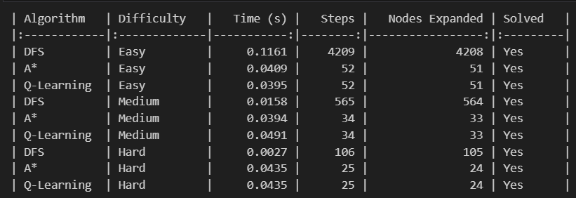
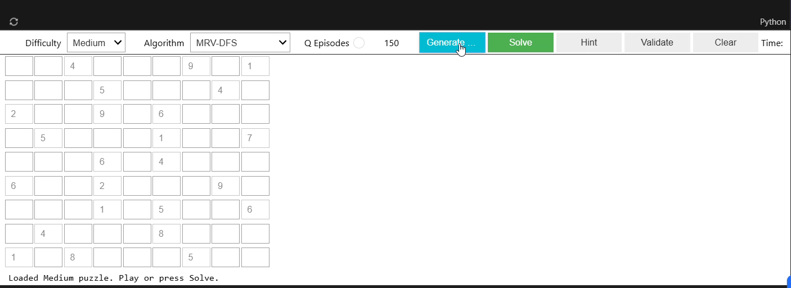
RESULTS
Demo Representation and results of my Application

Slide 6
CHALLENGES AND SOLUTION
Creating a Sudoku solver app that combines DFS, A*, and potentially Q-Learning was both exciting and challenging. One of the main difficulties was implementing the solving algorithms themselves. DFS with backtracking is simple in concept, but for medium and hard puzzles, it can become very slow because it blindly tries many possibilities and backtracks a lot. To handle this, I made sure that each number placed in a cell was checked for validity first, so the solver wouldn’t waste time going down obviously wrong paths. This simple pruning made DFS much faster and more practical.
A* search brought a different set of challenges. Unlike DFS, A* needs a heuristic to guide the search toward the solution efficiently. Designing a good heuristic for Sudoku wasn’t straightforward. I decided to use the number of empty cells as a heuristic, so boards closer to completion were explored first. Implementing A* also required managing a priority queue and avoiding revisiting the same board configuration multiple times. To solve this, I stored each board state as a string in a set to make sure the algorithm only worked on new states.
Building the user interface with Tkinter was another big challenge. Sudoku has a 9×9 grid, and making it interactive, visually clear, and easy to use took careful planning. Each cell was represented with an input box, and I stored them in a 2D list to read and update values easily. I added buttons for loading puzzles of different difficulties, solving with DFS or A*, and resetting the board. Handling user input correctly was also important because users could type letters or leave cells empty. I handled this by converting invalid inputs to zero, which works nicely with both algorithms.
Performance was another concern. DFS and A* can take some time on harder puzzles, which could make the interface feel frozen. While multithreading could improve responsiveness, I focused on tracking performance metrics like time taken, nodes expanded, and steps to understand how each algorithm behaves. Visualizing these metrics with bar graphs helped me compare DFS and A* across puzzle difficulties, giving a clear picture of their efficiency and computational cost.
Finally, I considered implementing Q-Learning. Sudoku has a huge state space—far too big for standard Q-Learning to handle efficiently on a 9×9 board. Because of this, I focused on DFS and A* for now, which are deterministic and guarantee correct solutions. Q-Learning remains a potential future enhancement, especially if applied to smaller boards or simplified versions of the puzzle.

Slide 7
PROFFESSIONAL CONCERNS
Performance & Scalability: Optimize for medium/hard puzzles; avoid long computation times.
User Interface & Usability: Intuitive 9×9 grid, clear buttons, and responsive design.
Maintainability & Extensibility: Modular code to add future solvers like Q-Learning easily.
Algorithm Correctness: Ensure DFS and A* always produce valid Sudoku solutions.
Input Validation & Data Integrity: Handle invalid or empty input safely.
Reproducibility & Metrics: Track nodes expanded, steps, and execution time for analysis.
Accessibility & Ethics: Clear fonts, grid visibility, and user-friendly layout for all users.

Slide 8
CONCLUSION
In this project, a Sudoku solver application was successfully developed using DFS and A* algorithms, with a focus on correctness, efficiency, and usability. DFS with backtracking provided a straightforward, systematic approach to explore possible solutions, while A* used a heuristic to guide the search efficiently, reducing unnecessary computations. The application features an interactive Tkinter-based UI, allowing users to load puzzles of varying difficulty, solve them with either algorithm, and visualize results.
Challenges such as handling complex puzzle states, ensuring performance, validating user input, and designing a clear interface were addressed through careful algorithm design, modular code structure, and effective UI practices. Performance metrics like nodes expanded, steps, and time were collected to analyze and compare algorithm efficiency.
While DFS and A* guarantee correctness, implementing Q-Learning for Sudoku remains a potential future enhancement due to the large state space. Overall, this project demonstrates the integration of algorithmic problem solving, heuristic search, and user-centered design, providing a robust and extensible Sudoku solving tool.

